Slide 1
Math 769: Statistical Learning

Slide 2
Bias-Variance Decomposition
Shahrzad Jamshidi, PhD

Slide 3
Last Time
Model Complexity
Bias-Variance tradeoff
Different loss functions related to error
Testing error versus expected testing error
Training-Validation-Test split of the dataset

Slide 4
Objectives
Explain the error decomposition into irreducible error, bias, and variance.
Describe this decomposition with a diagram from the textbook.

Slide 5
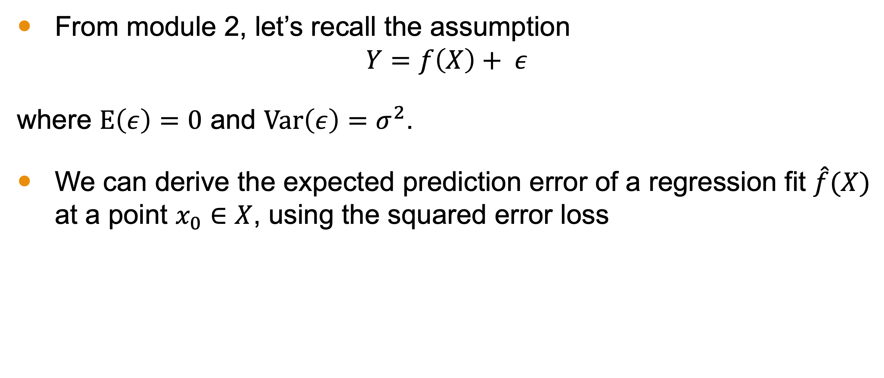
Bias-Variance Decomposition
From module 2, let’s recall the assumption
$$Y=f\left(X\right)+ ε$$
where $E\left(ε\right)=0$ and $Var\left(ε\right)=σ^{2}$.
We can derive the expected prediction error of a regression fit $\hat{f}(X)$ at a point $x_{0}∈X$, using the squared error loss

Slide 6
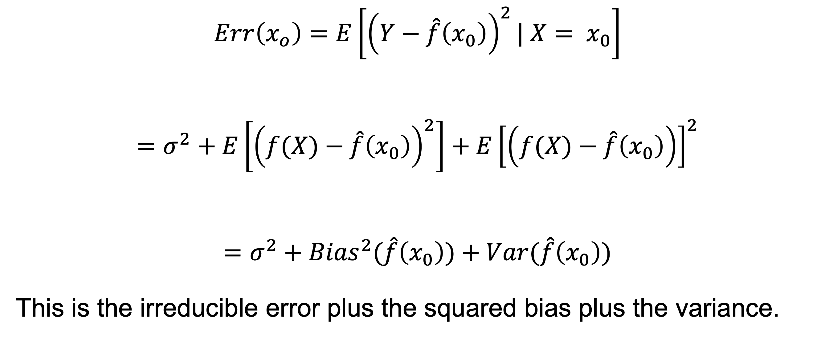
Expected Prediction Error at a Point
$$Err\left(x_{o}\right)=E\left[{\left(Y−\hat{f}\left(x_{0}\right)\right)}^{2}| X= x_{0}\right]$$
$$=σ^{2}+E\left[{\left(f(X)−\hat{f}\left(x_{0}\right)\right)}^{2}\right]+E{\left[\left(f(X)−\hat{f}\left(x_{0}\right)\right)\right]}^{2}$$
$$=σ^{2}+{Bias}^{2}(\hat{f}\left(x_{0}\right))+Var(\hat{f}\left(x_{0}\right))$$
This is the irreducible error plus the squared bias plus the variance.

Slide 7
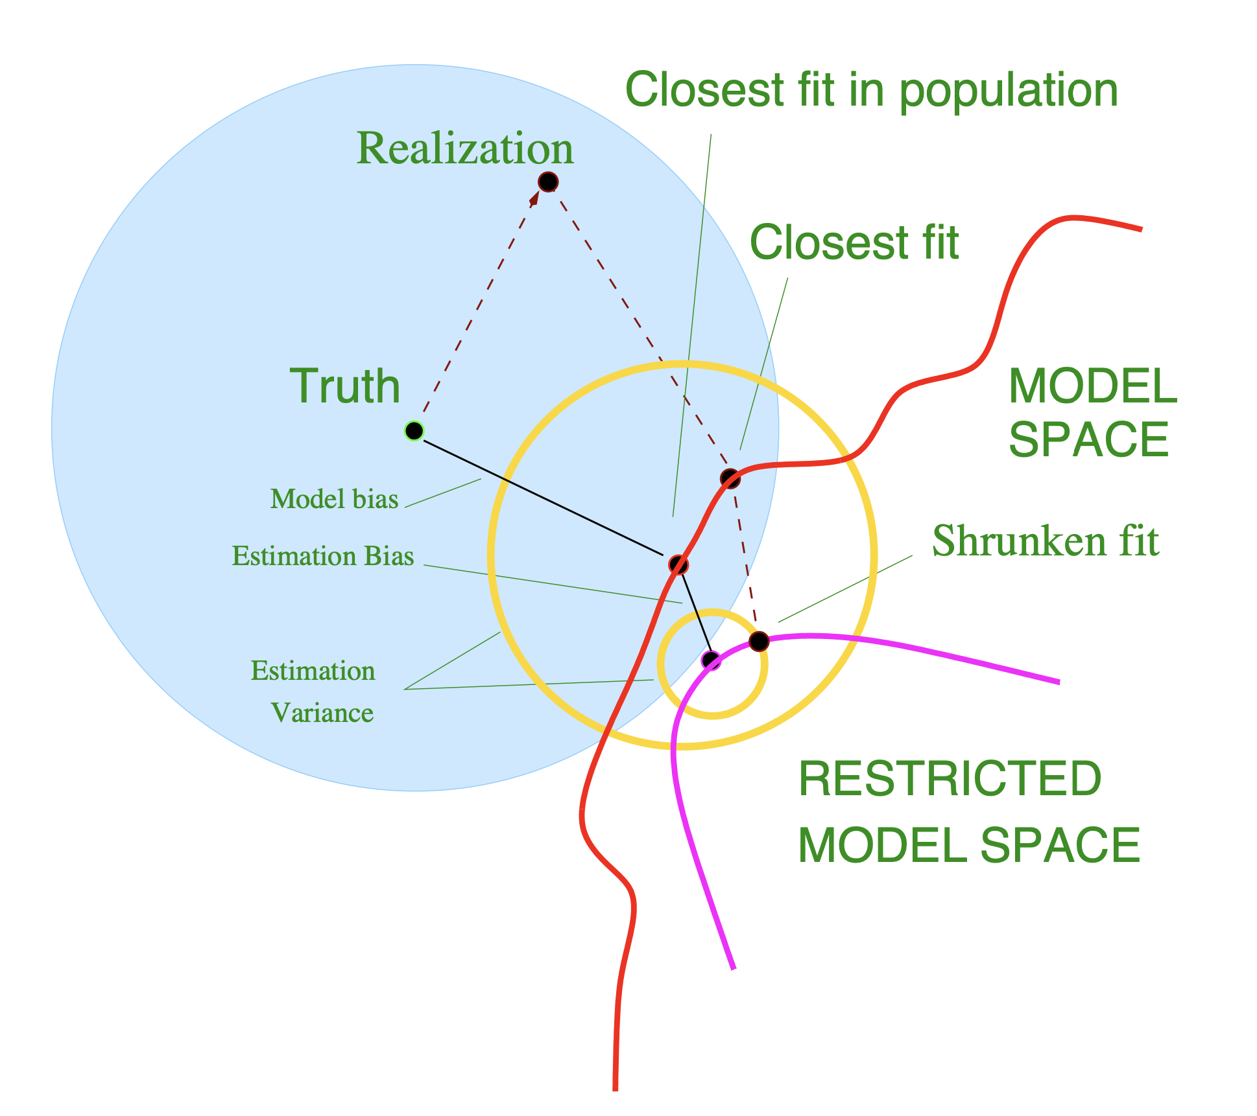
Bias and Variance Visually
This diagram illustrates the idea of bias and variance.
The blue circle is the set of all possible datasets.
Truth is the dataset with no noise.
Realization is the dataset we end up with.

Slide 8
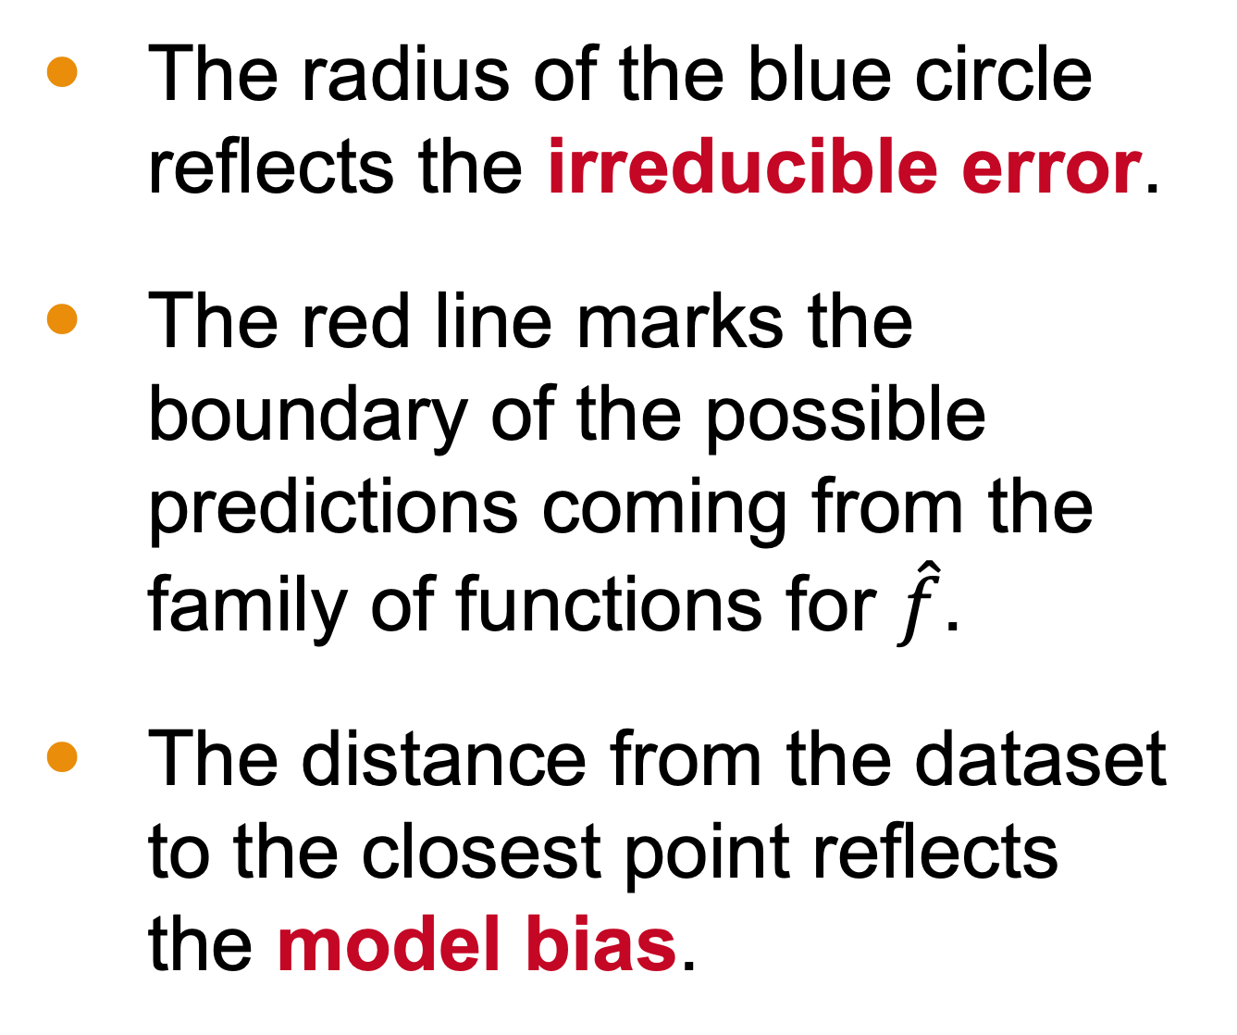
Bias and Variance Visually
The radius of the blue circle reflects the irreducible error.
The red line marks the boundary of the possible predictions coming from the family of functions for $\hat{f}$.
The distance from the dataset to the closest point reflects the model bias.

Slide 9
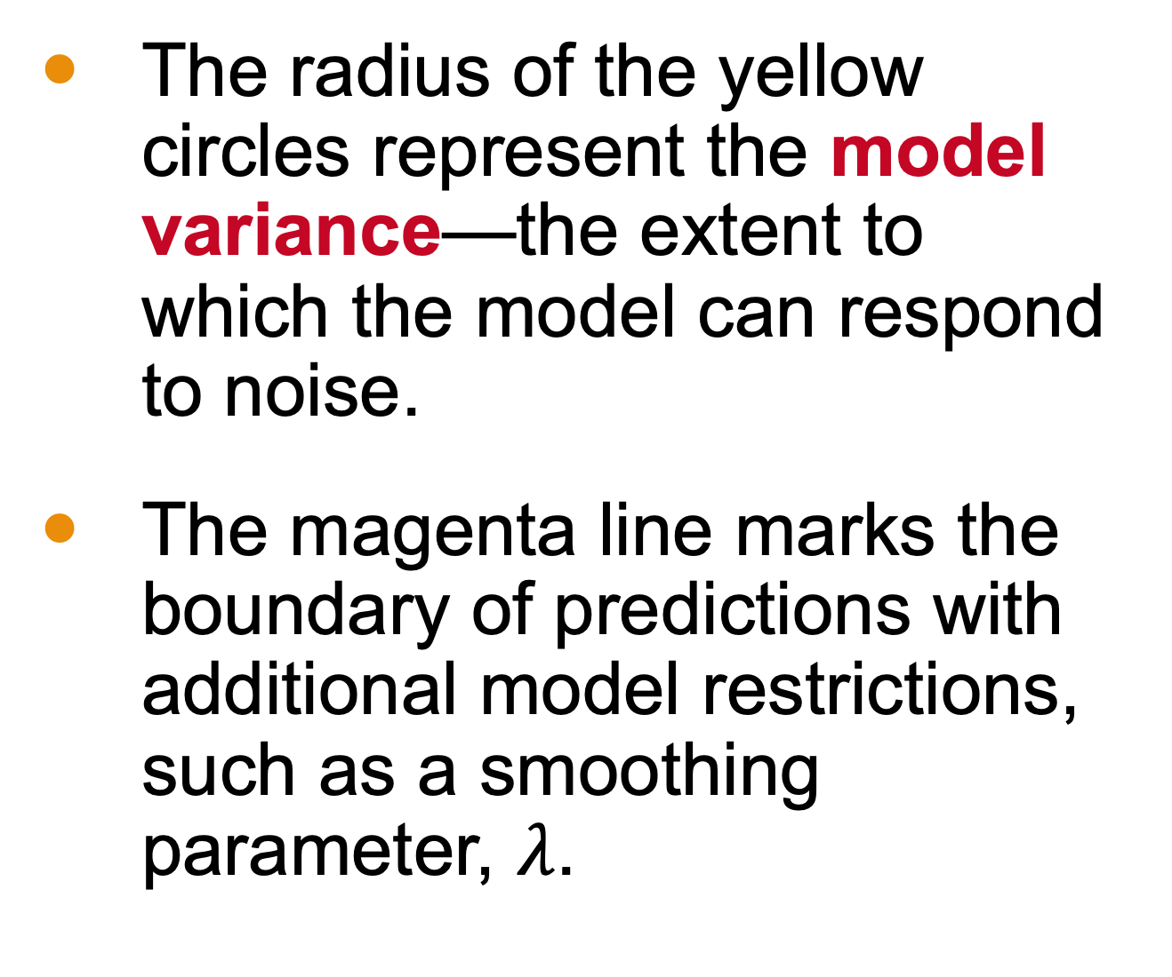
Bias and Variance Visually
The radius of the yellow circles represent the model variance—the extent to which the model can respond to noise.
The magenta line marks the boundary of predictions with additional model restrictions, such as a smoothing parameter, $λ$.

Slide 10
Bias and Variance Visually
Notice that the variance for the restricted models is lower even though the bias (the distance from the dataset) is higher!
This is why some biased estimators can produce a lower predicted error.

Slide 11
Bias and Variance Visually
Error is the sum of
The radius of the blue circle (irreducible error)
The radius of the yellow circle (model variance)
The distance from the actual data to the predicted data (model bias)

Slide 12
Bias and Variance Visually
We do not have access to the information represented by the solid line
We do have access to the distance between our realization and the model spaces.
This allows us to estimate model bias.

Slide 13
Conclusion
The model error can be broken down into
Irreducible error
Model bias
Model Variance
Sometimes we introduce more bias to have less variance

